Slide 1

Decoding the Layers: Understanding the Architecture of CNN
Department of Master of Computer Applications
IV Semester
Code: MCAS1
By
Komal S kallangoudar
1ms22mc016
Under the Guidance of
Prof. Abhishek k l
Assistant professor

Slide 2
Agenda
Introduction
Literature Review
Research Gap Analysis
Social Impact
Implementation
Results
Conclusion
Future Work
References

Slide 3
Introduction
What is CNN?
Most significant architectures of CNN
YOLO – You Look only once
R-CNN - Region-based Convolutional Neural Network
Main objective of the seminar is to “Explain the CNN architecture specifically designed for object detection”

Slide 4
Literature Review
Improved Accuracy and Efficiency
Key Components of CNNs
Comprise convolutional, non-linearity, pooling, and fully connected layers, essential for reducing parameters and enhancing feature extraction
Pattern Recognition Capabilities

Slide 5
Research Gap Analysis
Combining Extracted Features
Increasing Probability of Correct Classification
Final Decision Making
Optimization through Backpropagation

Slide 6
Social Impact
The advancements in CNN for real-time object detection have significant contributions to society across various domains
Improved Safety and Operational Efficiency in Autonomous Vehicles
Improved Security and Surveillance
Advancements in Healthcare
Smart Cities and IoT Applications

Slide 7
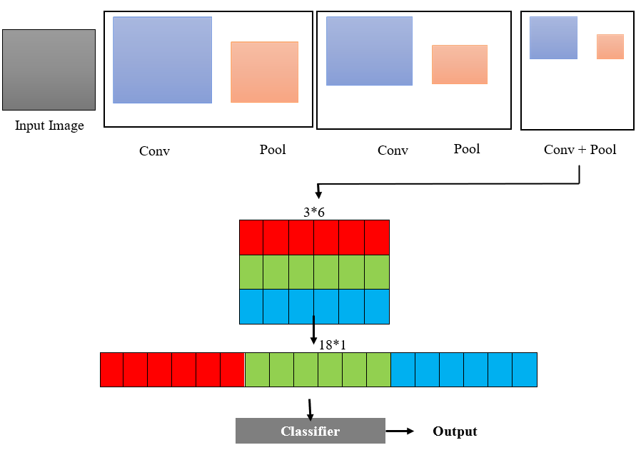
Implementation
General types of layers found in CNN
Convolutional Layers
Pooling Layers
Fully Connected Layers
Figure 1: CNN Architecture

Slide 8
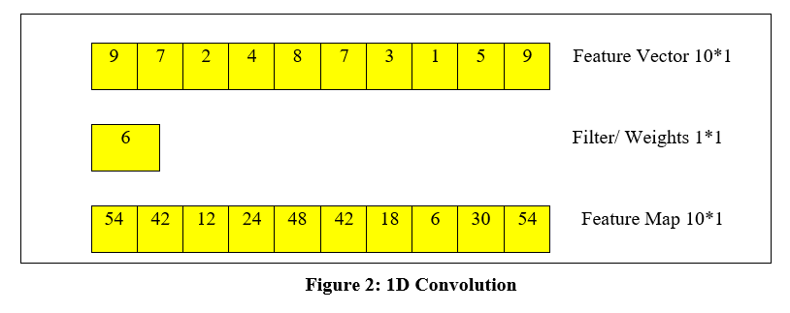
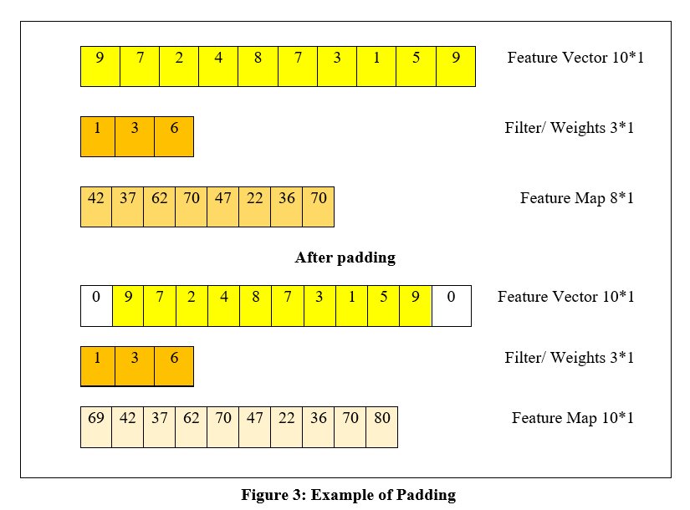
Convolutional Layers
Convolution is a mathematical operation where a filter slides over the input data to produce an output. This process involves the dot product of the filter and the sub-regions of the input.
We can calculate the size of output map using the formula
((W-F+2P)/S)+1
W – size of Feature Vector, F - Size of filter, P – Padding size, S – amount of slide of filter

Slide 9
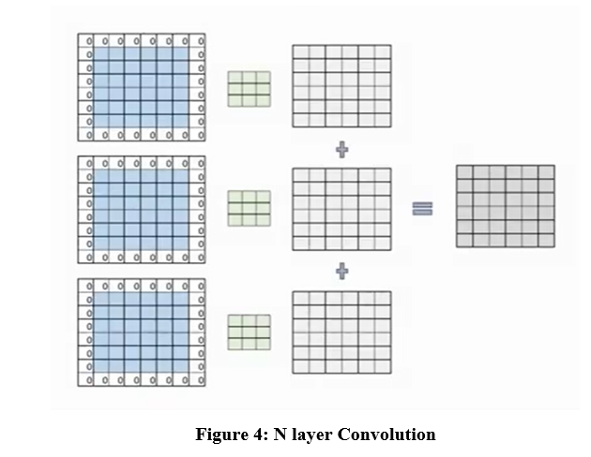
Convolutional Layers
N layer Convolution
Each layer in a CNN contributes to hierarchical feature learning
More layers increase the model's capacity and complexity

Slide 10
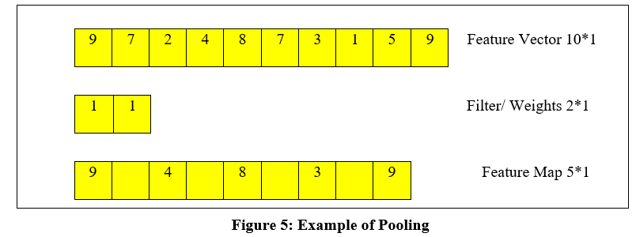
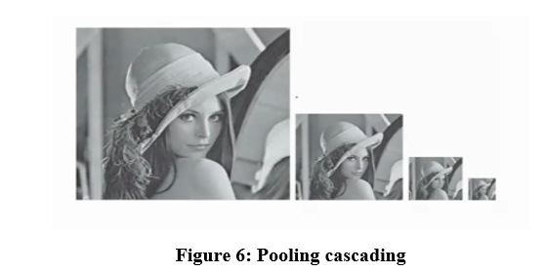
Pooling Layers
Pooling layers are a crucial component in CNNs that serve to downsample the feature maps produced by convolutional layers. They play a vital role in reducing the spatial dimensions of the input while retaining the most important features
Cascading pooling layers in convolutional neural networks is crucial as it serves multiple purposes.

Slide 11
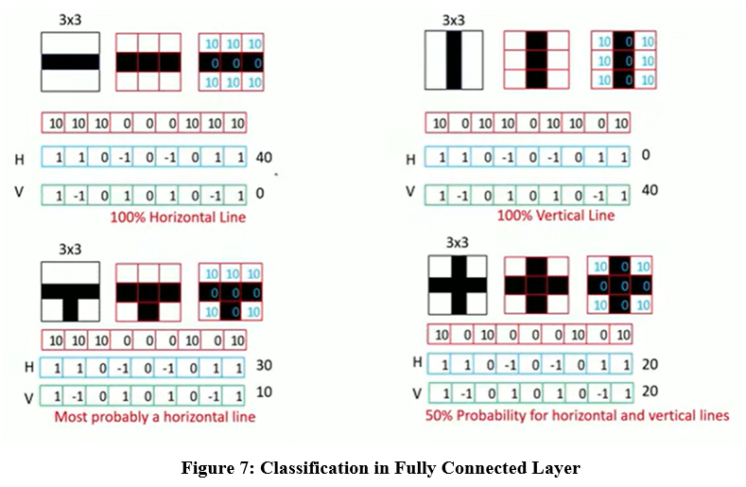
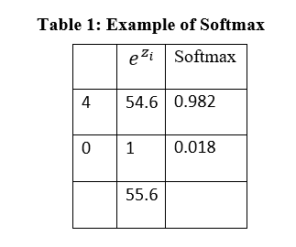
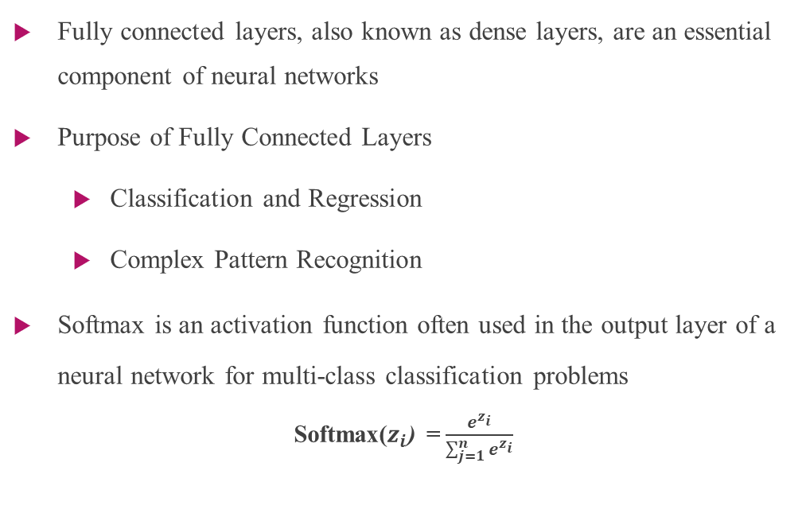
Fully Connected Layers
Fully connected layers, also known as dense layers, are an essential component of neural networks
Purpose of Fully Connected Layers
Classification and Regression
Complex Pattern Recognition
Softmax is an activation function often used in the output layer of a neural network for multi-class classification problems
Softmax($z_{i}$) = $\frac{e^{z_{i}}}{\sum_{j=1}^{n}{e^{z_{i}}}}$

Slide 12
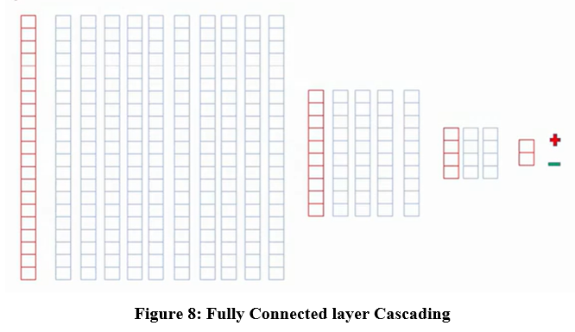
Fully Connected layer Cascading
Increasing Probability of Correct Classification
Enhancing Classification Accuracy Apply different filters for input vector to get output map.
Optimization through Backpropagation

Slide 13
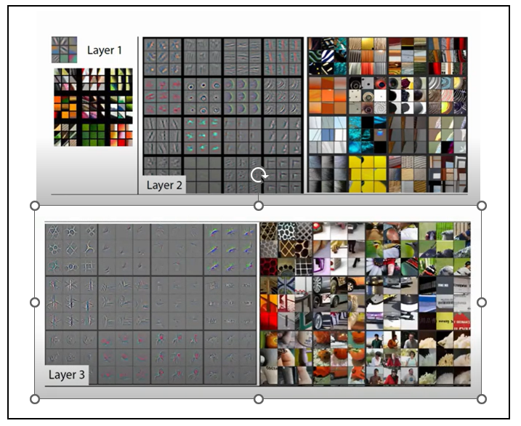
Results
Cascade Convolutional Layers
Hierarchical Feature Extraction
Complexity Management
Improved Learning and Performance

Slide 14
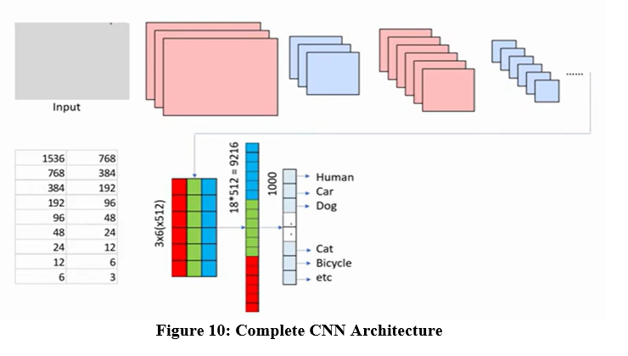
Conclusion
Complete CNN Architecture
Feature Extraction through Convolutional Layers
Dimensionality Reduction with Pooling Layers
Hierarchical Feature Representation
Effective and Accurate Image Classification

Slide 15
Future Work
Optimization Techniques.
Advanced CNN Architectures
Transfer Learning
Cross-Domain Applications

Slide 16
References
Shaukat Hayat, She Kun, Zuo Tengtao, Yue Yu, Tianyi Tu, Yantong Du worked on A Deep Learning Framework Using Convolutional Neural Network for Multi-class Object Recognition paper released in 2018 3rd IEEE International Conference on Image, Vision and Computing https://ieeexplore.ieee.org/document/8492777
Zewen Li, FanLiu,Wenjie Yang, Shouheng,Peng and Jun Zhou worked on A Survey of Convolutional Neural Networks: Analysis, Applications, and Prospects paper released in IEEE TRANSACTIONS ON NEURAL NETWORKS AND LEARNING SYSTEMS, VOL. 33, NO. 12, DECEMBER 2022 https://ieeexplore.ieee.org/document/9451544
Rahul Chauhan, Kamal Kumar Ghanshala, R.C Joshi worked on Convolutional Neural Network (CNN) for Image Detection and Recognition paper released in 2018 First International Conference on Secure Cyber Computing and Communication (ICSCCC) https://ieeexplore.ieee.org/document/8703316
Prasoon Bharat Mishra1, Abdul Malik2, M.Safa, Saranaya G4,Arun D5 worked on Enhanced Object Detection with Deep Convolutional Neural Networks for Vehicle Detection paper released in 2022 International Conference on Power, Energy, Control and Transmission Systems (ICPECTS) https://ieeexplore.ieee.org/document/10047323

Slide 17
References
Xin Hu, Hua Ouyang and Yang Yin worked on Image Recognition based on Convolution Neural Network paper released in 2020 IEEE 9th Joint International Information Technology and Artificial Intelligence Conference (ITAIC) https://ieeexplore.ieee.org/document/9339197
Prof. Sujata Bhairnallykar, Aniket Prajapati, Anurag Rajbhar, Sahil Mujawar worked on Convolutional Neural Network (CNN) for Image Detection paper released in International Research Journal of Engineering and Technology (IRJET) 2020 https://www.irjet.net/archives/V7/i11/IRJET-V7I11204.pdf
Reagan L. Galvez, Ryan Rhay P. Vicerra, Elmer P. Dadios, Argel A. Bandala, Jose Martin Z. Maningo worked on Object Detection Using Convolutional Neural Networks Proceedings of TENCON 2018 - 2018 IEEE Region 10 Conference (Jeju, Korea, 28-31 October 2018) https://ieeexplore.ieee.org/abstract/document/8650517
Saad ALBAWI, Tareq Abed MOHAMMED and Saad AL-ZAWI worked on Understanding of a Convolutional Neural Network paper released in ICET2017, Antalya, Turkey https://ieeexplore.ieee.org/document/8308186

